Slide 1
Hawkins Sports Juniors FC
2022 - 2023

Slide 2
Use this planner to set goals and tasks you need to complete. These may focus on tasks to form the club identity, create a successful structure, ensure you have the right people in the right roles, develop effective financial planning, and to identify and secure the required facilities for your club.
Top Tips: Visit our England Football League and Club Hub on YouTube for helpful ideas and insights.
Visit our England Football Learning website for ideas to help you develop your football philosophy.
Also, take a look at our Club Structures Guide created in partnership with Muckle LLP.
New Changing room facility | Grants from Football Foundation and Local Business’s | Within the next five years 2023 -2028. | Chris Burton and Karl Hadlington | To be advised | Every September at the start of each new season.
Dug Outs for main pitch No1. | Sponsorship from local business’s | 2022-2023 season. | Chris Burton | £3,000 to £5,000 | May 2023
New Catch nets to allow pitch 2 to be re-sited. | In house funding from our own Annual Tournament | 2022-2023 season | Chris Burton | £1,500 to £2,500 | June 2023
New 9 v 9 pitch | In house funding from our own football Tournament | 2022-2023 season | Chris Burton | £500 to £1,000 | May 2023
Drainage system by main sports gate | Grant Funding and In house funding | 2022-2024 season | Chris Burton John Webb | £800 to £1,700 | June 2023

Slide 4
Charter Standard since November 2008.
Charter Standard Club of the Year 2012
Runner Up Groundsman of the year three years running 2015, 2016, 2017.
Active Soccer School since 2003
Our club colours are Navy and Yellow, in addition we have our own club shop setup in Partnership with Pendle Sportswear for both Managers and Members.
Our Club was founded in August 2003 with just 7 players, we now have well over 200 players in our club.
We have a team at every age group from under 7’s to Under 21’s. In addition three Senior teams and a Veterans team.
We have been part of the pitch improvement plan since 2011 now supporting 11 teams from only 4 on our home ground
Our Major Football Tournament held every year on the fathers day weekend sells out every year with 96 teams and eight age groups.
Our own website since 2006.
We became self funding for our ground and changing facilities in August 2020.
We now have brand new Equipment through the Football Foundation Grant to look after our facility since July 2020.
To obtain new changing room facilities with additional changing rooms to accommodate our additional teams that play on our home ground.
Although we have several boys and men’s teams we have put an application in to join the Wildcats scheme to hopefully develop some girls teams.

Slide 5
Changing Rooms
Girls Team
Dug Outs
Community Club
We are looking to gain funding initially with the Football Foundation, and additional sponsors to build a new changing room facility. We are hoping to attract local businesses to help us achieve this goal.
Application applied for Wildcats scheme to gain and start producing our first girls teams as an additional alternative to other local clubs. Hoping to attract girls from local areas.
We are currently aiming to add a home and away dug out to our main pitch. We hopefully have the support of a local business on this goal.
We aim to provide football at as many different levels as possible. Providing alternative events in addition to just football.

Slide 6
We want people to see us as a well run club, which we have achieved so far with many compliments and the number of people enquiring to join us.
Our good reputation is very important to us.
We are continually striving to ensure that we are seen as a Club with the interests of our local Community at heart.
We like to ensure that anyone who joins us or takes part in any of our activities enjoy their footballing experience whilst with us.
With our good communication skills, we are pleased that anyone that interacts with our club and events that we hold are kept well informed and enjoy their time whilst with our club.
Our own Website and Facebook has been a large part of our success.

Slide 8
CLUB STRUCTURE
CHAIRPERSON
Chris Burton
TREASURER
SECRETARY
WELFARE OFFICER
Lesley Burton
Lesley Burton
Chris Burton
Assistant Welfare Officer
Public Relations Officer
Vice Chairman
Andrew Harrison
Trevor Payne
Karl Hadlington

Slide 9
Good Communication.
Developing a Family feel to our club.
Making members feel wanted and part of our structure.
Periods when we are short of volunteers to help with tasks to keep our club running smoothly.
Always on the lookout for any further grant funding to enhance our facility.
Any volunteers are always welcomed and encouraged to ensure the future of our club.
All positions are well delegated to ensure that people wish to be part of our future.
Our main threat would be if our main Sports Club was to close, which is why our members are encouraged to support our club by using it for additional events and after matches.

Slide 10

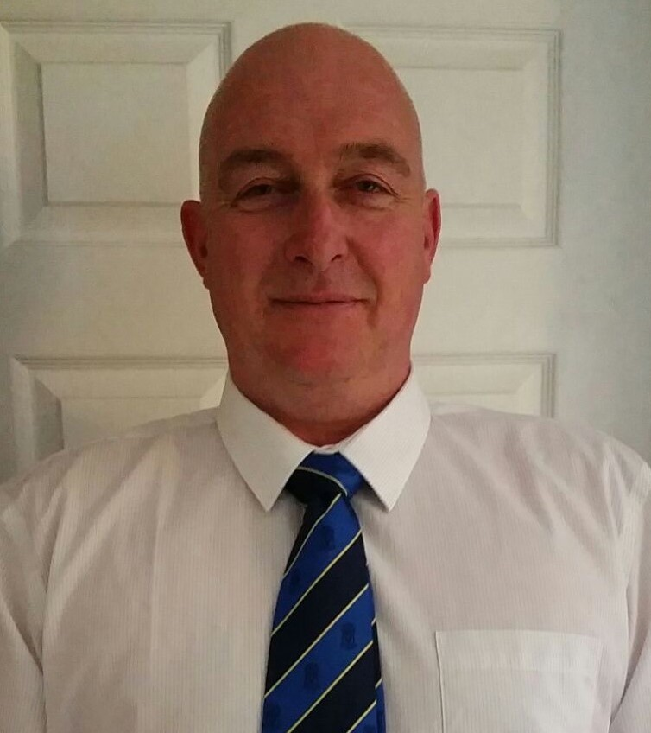


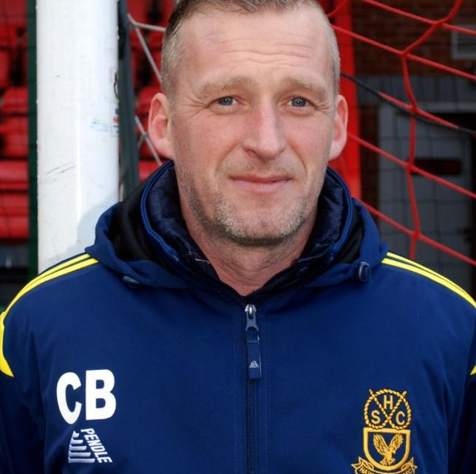
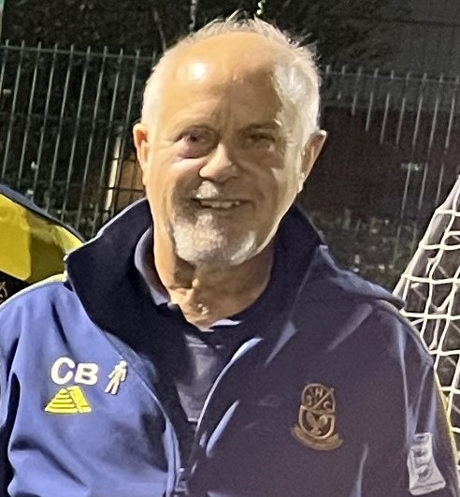
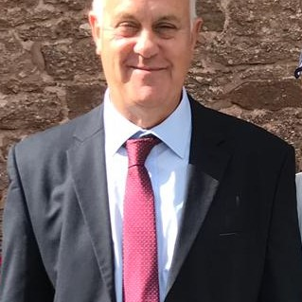
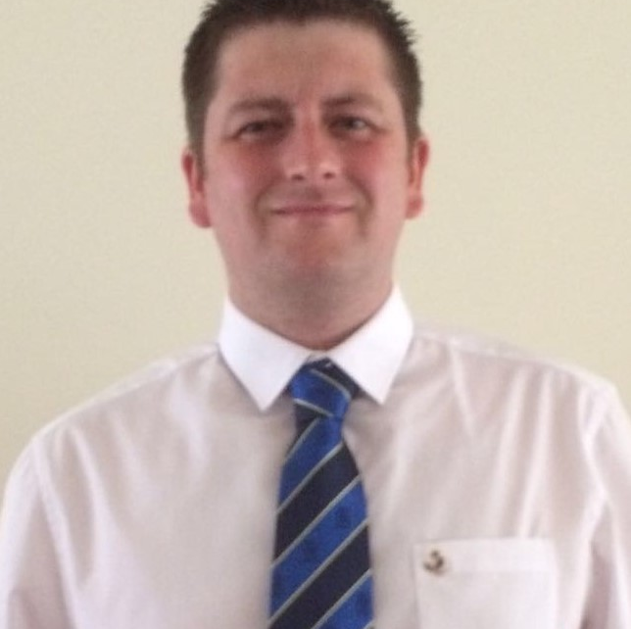
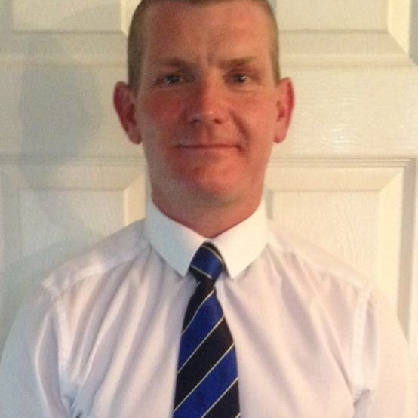
Vice Chairman
Honorary President
Chris Burton
Karl Hadlington
Roger Walmsley
Goalkeeping Coach
Groundsman
Lesley Burton
Craig Bishop
Chris Burton
Assistant Welfare
Public Relations
Chris Burton
Andrew Harrison
Trevor Payne

Slide 11
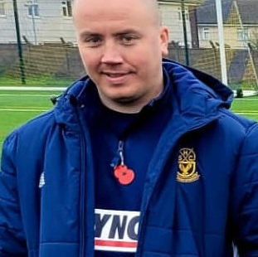
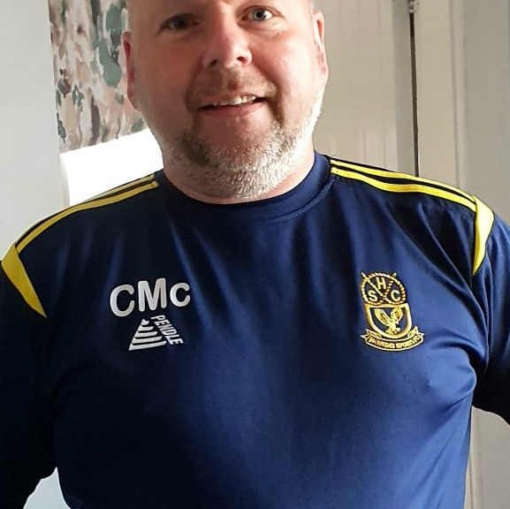
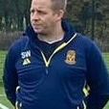
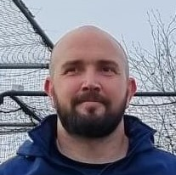
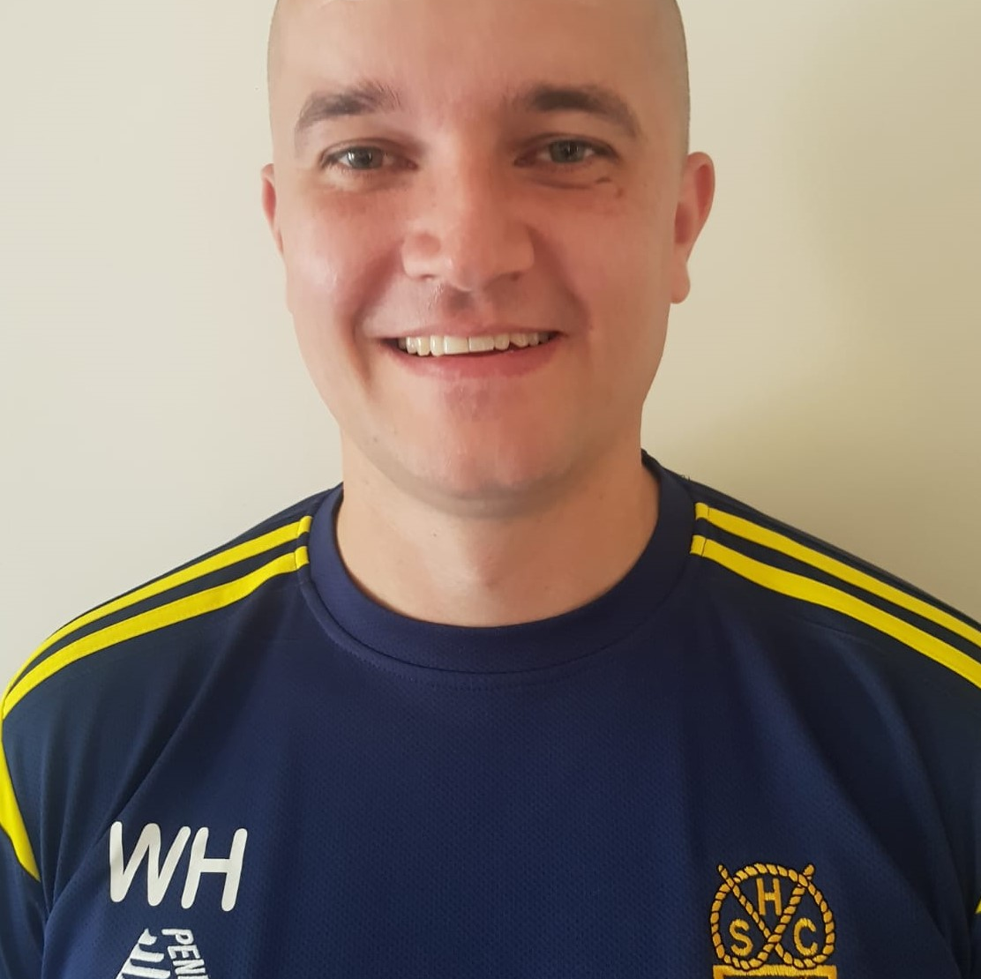
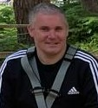
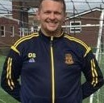
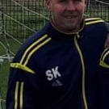
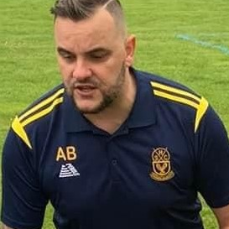
Under 8 Manager
Under 9 Eagles
Under 9 Falcons
Craig Wichurch
Callum Mcleish
Shaun Wileman
Under 9 Kestrels
Under 10 Falcons
Under 11 Eagles
Peter Noakes
Wayne Harris
Chris Rich
Under 11 Falcons
Under 12 Eagles
Under 12 Vipers
Daniel Smith
Stuart King
Andrew Birch

Slide 12
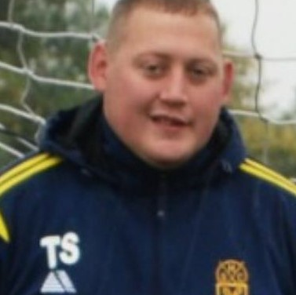
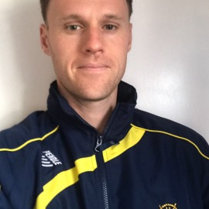
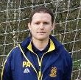
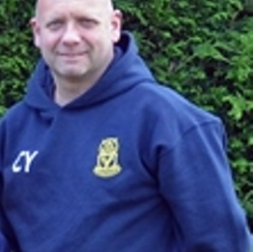
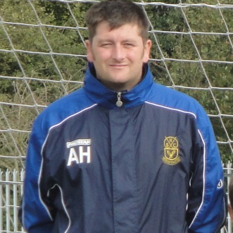
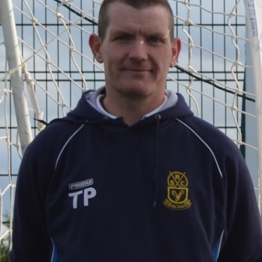
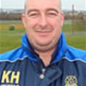
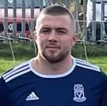
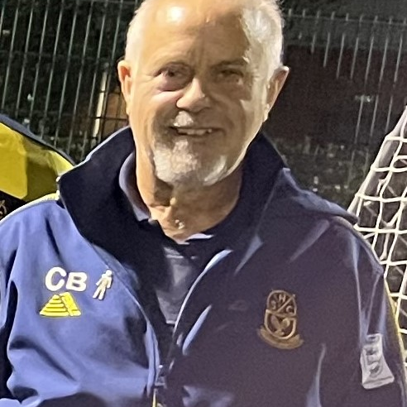
Under 13 Eagles
Under 14 Eagles
Under 15 Eagles
Tom Spragg
Greg Meacham
Paul Allen
Under 17 Eagles
Under 18 Eagles
Under 21 Eagles
Carl Yardley
Andrew Harrison
Trevor Payne
Saturday Open Age
Sunday Open Age
Hawkins Veterans
Karl Hadlington
Tom Finch
Chris Burton

Slide 14
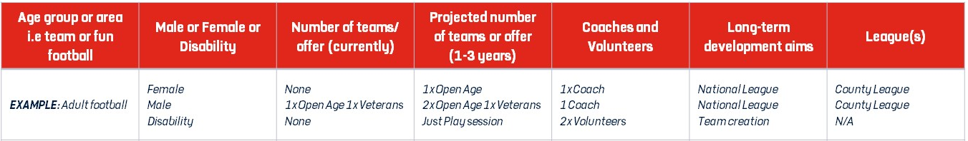
Adult Football | Male | 1 x open age | 4 x open age, 1 x Veterans | 5 Coaches 5 volunteers | Team creation | County Leagues
Junior Football | Mixed | Under 7’s | 2 x teams | 2 x coaches 2 x volunteers | Team creation | Mid Staffs Walsall Junior Lichfield League
Junior Football | Female | Under 7-9 years | Just play possible 2 x teams | 3 x coaches 2 x volunteers | Team creation | Mid Staffs Walsall Junior Lichfield League
Goalkeeper Coaching | Mixed | Under 7 to 16 | Additional training | 2 x coaches 2 x volunteers | Team development | N/A
Soccer School | Mixed | Ages 5 to 7 | Just play sessions with a view to develop new teams every season | 3 x coaches 2 x volunteers | Team creation and development | N/A

Slide 15
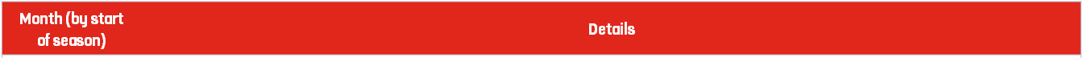
ADD IN SEASON HERE
September | Please see uploaded Coaching Planner for 2022-2023 season.
October
November
December
January
February
March
April
May

Slide 17
Total Projected Income | £40,000
Total Projected Expenditure | £37,000
Annual Balance | £3,000 - £5,000

Slide 18
Annual Accounts Sheet | Cost (£)
Club | Hawkins Sports Juniors FC
Year | Please see our Downloaded Annual Accounts Spreadsheet for the 2021-2022 season.
Income |  | Expenditure
Sponsorship |  | Affiliation
Subs |  | Pitch Hire
Donations |  | Training Hire
Grants |  | Referee Fees
Trips |  | Washing
 |  | Fines
Total Income |  | Total Expenditure
Opening Balance
+ Surplus / Deficit
Total / Closing Balance

Slide 19
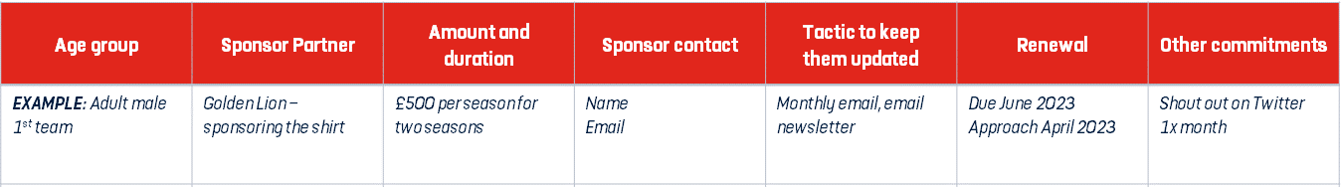
Adult male Saturday First Team | Venture One Logistics | Replacement kit | Chris Burton burton413@btinternet.com | N/A | Renewal August 2023 | n/a
Under 18’s | Ibstock Brick | Replacement kit and Training kit | Head of Sales | Facebook and own website | Renewal August 2023 | n/a
Under 17’s | Leamore Windows | Replacement kit and training wear | Tel No:01922-473737. | Facebook and own website |  | n/a
Under 7’s | L D Pipelines | New training Jackets £350 | John Carter Jon@ldpipelines.co.uk | Facebook and own website | Possible further sponsorship September 2023 | n/a

Slide 21
Club contact details
Club Name | Hawkins Sports Juniors FC
Club Address | Coppice Lane, Cheslyn Hay | Postcode | WS6 7EY
Telephone | 01922-417286
Access routes
For Ambulance | Main access drive to sports ground
From Pitch to Ambulance | Pitches are close to access drive
Other Information
Nearest A&E / Trauma Hospital | New Cross Hospital, Heath Twon, Wolverhampton WV10 0QP.
Fastest Route to A&E / Trauma Hospital | Coppice Lane, onto A5, then onto A460 Cannock to Wolverhampton Road..
Distance and Journey time | 7.9 Mile. Approx 21 minutes.
Nearest Walk-in Centre | Cannock Hospital, Brunswick Road, Cannock WS11 5XY.
Alternative Trauma Hospital | Manor Hospital, Moat Road, Walsall WS2 9PS.
First Aider / Helper Information
Name | Chris Burton | Mobile number | 07791-919766
For queries about this EAP | Contact Chris Burton on the mobile number provided above or alternatively Lesley Burton on 07969-105588.
See relevant coach for First Aider on day of match | All Managers are First Aid trained in addition most of their assistants are.
First Aid Equipment and Facilities
Item | Location
Defibrillator | X 2 Outside Changing Rooms, Main Club Entrance Door
Stretcher | No
First Aid Room | Yes (Hospitality Room) to left side of Changing rooms.

Slide 22
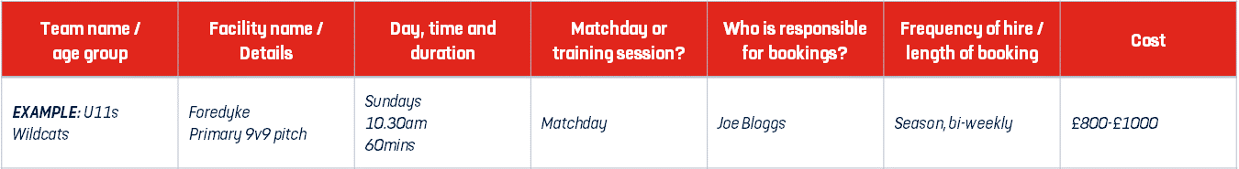
Under 11’s Under 12’s | 9 v 9 pitch | Sundays 10.30 and 2.00pm | Sundays | Chris Burton | Weekly | £300 per season
Under 13’s Under 14’s | 11 v 11 pitch 11 v 11 pitch | 10.30am and 2.00pm | Sundays | Chris Burton | Weekly | £300 per season
Under 15’s Under 17’s | 11 v 11 pitch | 2.00pm | Sundays | Chris Burton | Weekly | £300 per season
Under 18’s Under 21’s | 11 v 11 pitch | 2.00pm | Sundays | Chris Burton | Weekly | £300 Per season
Saturday open age | 11 v 11 pitch | 2.00pm | Saturdays | Chris Burton | Bi-weekly | £600 per season
Sunday open age x 2 | 11 v 11 pitch | 10.30am | Sundays | Chris Burton | Weekly | £600 per season

Slide 26
England Football Resources
England Football – Leagues & Clubs
England Football Accreditation
Club Learning Opportunities
YouTube - The League and Club Hub
England Football Learning
Club Resources
Club Structures Guide
Contact details for County FAs
Other Grassroots Support
Football Foundation
Football Foundation – Local Plans
Sport England
Sport England – Funding

